Slide 1
OOSE Chapter 1
INTRODUCTION

Slide 2
Chapter 1 - Introduction
1.1 Software Engineering
Layered Technology
Application
Process Framework
Process Flow
CMMI

Slide 3
Software Engineering
The quest of attempting answer to following questions:
• Why does it take so long to get software finished?
• Why are development costs so high?
• Why can’t we find all errors before we give the software to our customers?
• Why do we spend so much time and effort maintaining existing programs?
• Why do we continue to have difficulty in measuring progress as software is being developed and maintained?

Slide 4
Software Engineering
These, and many other questions, are a manifestation of the concern about software and the manner in which it is developed—a concern that has lead to the adoption of software engineering practice.

Slide 5
What is Software?
Textbook description of software might take the following form:
Software is:
(1) instructions (computer programs) that when executed provide desired features, function, and performance;
(2) data structures that enable the programs to adequately manipulate information, and
(3) descriptive information in both hard copy and virtual forms that describes the operation and use of the programs.

Slide 6
What differentiate software from hardware?
Software is developed or engineered; it is not manufactured in the classical sense.
Software doesn’t “wear out.”
Although the industry is moving toward component-based construction, most software continues to be custom built.

Slide 7
Software Application Domain
System software—a collection of programs written to service other programs. Some system software
e.g., compilers, editors, and file management Utilities
processes complex, but determinate information structures.

Slide 8
Software Application Domain
Engineering/scientific software—has been characterized by “number crunching” algorithms.
Applications range from astronomy to volcanology, from automotive stress analysis to space shuttle orbital dynamics, and from molecular biology to automated manufacturing.

Slide 9
Software Application Domain
Application software—stand-alone programs that solve a specific business need.
Applications in this area process business or technical data in a way that facilitates business operations or management/technical decision making.

Slide 10
Software Application Domain
Embedded software—resides within a product or system and is used to implement and control features and functions for the end user and for the system itself.
Embedded software can perform limited and esoteric functions (e.g., key pad control for a microwave oven) or provide significant function and control capability (e.g., digital functions in an automobile such as fuel control, dashboard displays, and braking systems).

Slide 11
Software Application Domain
Product-line software—designed to provide a specific capability for use by many different customers.
Product-line software can focus on a limited and esoteric marketplace (e.g., inventory control products) or address mass consumer markets (e.g., word processing, spreadsheets, computer graphics, multimedia, entertainment, database management, and personal and business financial applications).

Slide 12
Software Application Domain
Web applications—called “WebApps,” this network-centric software category spans a wide array of applications. In their simplest form, WebApps can be little more than a set of linked hypertext files that present information using text and limited graphics.
However, as Web 2.0 emerges, WebApps are evolving into sophisticated computing environments that not only provide stand-alone features, computing functions, and content to the end user, but also are integrated with corporate databases and business applications.

Slide 13
Software Application Domain
Artificial intelligence software—makes use of non numerical algorithms to solve complex problems that are not amenable to computation or straightforward analysis.
Applications within this area include robotics, expert systems, pattern recognition (image and voice), artificial neural networks, theorem proving, and game playing.

Slide 14
Challenges for Software development
Software has become deeply embedded in virtually every aspect of our lives, and as a consequence, the number of people who have an interest in the features and functions provided by a specific application has grown dramatically.
It follows that a concerted effort should be made to understand the problem before a software solution is developed.

Slide 15
Challenges for Software development
The complexity of these new computer-based systems and products demands careful attention to the interactions of all system elements.
It follows that design becomes a pivotal activity.

Slide 16
Challenges for Software development
If the software fails, people and major enterprises can experience anything from minor inconvenience to catastrophic failures.
It follows that software should exhibit high quality.

Slide 17
Challenges for Software development
As the perceived value of a specific application grows, the likelihood is that its user base and longevity will also grow.
As its user base and time-in-use increase, demands for adaptation and enhancement will also grow.
It follows that software should be maintainable.

Slide 18
Software Engineering
These lead to one conclusion: software in all of its forms and across all of its application domains should be engineered.
And that leads us to the topic —software engineering.

Slide 19
Software Engineering
Although hundreds of authors have developed personal definitions of software engineering, a definition proposed by Fritz Bauer [Nau69] at the seminal conference on the subject still serves as a basis for discussion:
[Software engineering is] the establishment and use of sound engineering principles in order to obtain economically software that is reliable and works efficiently on real machines.

Slide 20
Software Engineering
The IEEE [IEE93a] has developed a more comprehensive definition when it states:
Software Engineering: (1) The application of a systematic, disciplined, quantifiable approach to the development, operation, and maintenance of software; that is, the application of engineering to software. (2) The study of approaches as in (1)

Slide 21
Frequently asked Questions
What is software?
Computer programs and associated documentation.
Software products may be developed for a particular customer or may be developed for a general market.

Slide 22
Frequently asked Questions
What are the attributes of good software?
Good software should deliver the required functionality and performance to the user and should be maintainable, dependable, and usable.

Slide 23
Frequently asked Questions
What is software engineering?
Software engineering is an engineering discipline that is concerned with all aspects of software production.

Slide 24
Frequently asked Questions
What are the fundamental software engineering activities?
Software specification, software development, software validation, and software evolution.

Slide 25
Frequently asked Questions
What is the difference between software engineering and computer science?
Computer science focuses on theory and fundamentals; software engineering is concerned with the practicalities of developing and delivering useful software.

Slide 26
Frequently asked Questions
What is the difference between software engineering and system engineering?
System engineering is concerned with all aspects of computer-based systems development including hardware, software, and process engineering.
Software engineering is part of this more general process.

Slide 27
Frequently asked Questions
What are the key challenges facing software engineering?
Coping with increasing diversity,
demands for reduced delivery times, and
developing trustworthy software

Slide 28
Frequently asked Questions
What are the costs of software engineering?
Roughly 60% of software costs are development costs; 40% are testing costs.
For custom software, evolution costs often exceed development costs.

Slide 29
Frequently asked Questions
What are the best software engineering techniques and methods?
While all software projects have to be professionally managed and developed, different techniques are appropriate for different types of system.
For example, games should always be developed using a series of prototypes whereas safety critical control systems require a complete and analyzable specification to be developed.
You can’t, therefore, say that one method is better than another.

Slide 30
Frequently asked Questions
What differences has the Web made to software engineering?
The Web has led to the availability of software services and the possibility of developing highly distributed service-based systems.
Web-based systems development has led to important advances in programming languages and software reuse.

Slide 31
Layered Technology
Software engineering is a layered technology.

Slide 32

Layered Technology
Quality Focus:
Any engineering approach (including software engineering) must rest on an organizational commitment to quality.
Total quality management, Six Sigma, and similar philosophies10
foster a continuous process improvement culture, and it is this culture that ultimately leads to the development of increasingly more effective approaches to software engineering.
The bedrock that supports software engineering is a quality focus.

Slide 33
Layered Technology
Process:
The foundation for software engineering is the process layer.
The software engineering process is the glue that holds the technology layers together and enables rational and timely development of computer software.
Process defines a framework that must be established for effective delivery of software engineering technology.

Slide 34
Layered Technology
The software process forms the basis for
management control of software projects and
establishes the context in which technical methods are applied, work products (models, documents, data, reports, forms, etc.) are produced,
milestones are established,
quality is ensured, and
change is properly managed.

Slide 35
Layered Technology
Methods:
Software engineering methods provide the technical how-to’s for building software.
Methods encompass a broad array of tasks that include communication, requirements analysis, design modeling, program construction, testing, and support.
Software engineering methods rely on a set of basic principles that govern each area of the technology and include modeling activities and other descriptive techniques.

Slide 36
Layered Technology
Tools:
Software engineering tools provide automated or semi automated support for the process and the methods.
When tools are integrated so that information created by one tool can be used by another, a system for the support of software development, called computer-aided software engineering, is established.

Slide 37
Application of Software Engineering
There are software engineering fundamentals that apply to all types of software system:
1. They should be developed using a managed and understood development
process. The organization developing the software should plan the development
process and have clear ideas of what will be produced and when it will be completed.
2. Dependability and performance are important for all types of systems. Software should behave as expected, without failures and should be available for use when it is required. It should be safe in its operation and, as far as possible,
should be secure against external attack. The system should perform efficiently.

Slide 38
Application of Software Engineering
There are software engineering fundamentals that apply to all types of software system:
3. Understanding and managing the software specification and requirements (what the software should do) are important. You have to know what different customers and users of the system expect from it and you have to manage their expectations so that a useful system can be delivered within budget and to schedule.
4. You should make as effective use as possible of existing resources and should not waste resources. This means that, where appropriate, you should reuse software that has already been developed rather than write new software.

Slide 39
Process Framework
A generic process framework for software engineering defines five framework activities—communication, planning, modelling, construction, and deployment.

Slide 40
Process Framework
Communication
• Who has a stake in the solution to the problem? That is, who are the stakeholders?
• What are the unknowns? What data, functions, and features are required to properly solve the problem?
• Can the problem be compartmentalized? Is it possible to represent smaller problems that may be easier to understand?
• Can the problem be represented graphically? Can an analysis model be created?

Slide 41
Process Framework
Planning
• Have you seen similar problems before? Are there patterns that are recognizable in a potential solution? Is there existing software that implements the data, functions, and features that are required?
• Has a similar problem been solved? If so, are elements of the solution reusable?
• Can subproblems be defined? If so, are solutions readily apparent for the subproblems?
• Can you represent a solution in a manner that leads to effective implementation?

Slide 42
Process Framework
Modelling
• Does the solution conform to the plan? Is source code traceable to the design model?
• Is each component part of the solution provably correct? Have the design and code been reviewed, or better, have correctness proofs been applied to the algorithm?

Slide 43
Process Framework
• Is it possible to test each component part of the solution? Has a reasonable testing strategy been implemented?
• Does the solution produce results that conform to the data, functions, and features that are required? Has the software been validated against all stakeholder requirements?

Slide 44
Process Framework
A generic process framework for software engineering defines five framework activities—communication, planning, modeling, construction, and deployment.
In addition, a set of umbrella activities—project tracking and control, risk management, quality assurance, configuration management, technical reviews, and others—are applied throughout the process.

Slide 45
Process Framework

Slide 46
Process Framework
Defining a Framework Activity
What actions are appropriate for a framework activity, given the nature of the problem to be solved, the characteristics of the people doing the work, and the stakeholders who are sponsoring the project?

Slide 47
Process Framework
Identifying a Task Set
Each software engineering action can be represented by a number of different task sets—each a collection of software engineering work tasks, related work products, quality assurance points, and project milestones.

Slide 48
Process Framework
Task Set
A task set defines the actual work to be done to accomplish the objectives of a software engineering action.
For example, elicitation (more commonly called “requirements gathering”) is an important software engineering action that occurs during the communication activity.
The goal of requirements gathering is to understand what various stakeholders want from the software that is to be built.

Slide 49
Process Framework
Process Patterns
A process pattern describes a process-related problem that is encountered during software engineering work, identifies the environment in which the problem has been encountered, and suggests one or more proven solutions to the problem.

Slide 50
Process Framework- Example
For a small software project requested by one person (at a remote location) with simple, straightforward requirements, the communication activity might encompass little more than a phone call with the appropriate stakeholder.
Therefore, the only necessary action is phone conversation, and the work tasks (the task set) that this action encompasses are: 1. Make contact with stakeholder via telephone.
2. Discuss requirements and take notes.
3. Organize notes into a brief written statement of requirements.
4. E-mail to stakeholder for review and approval.

Slide 51
Process Flow
process flow—describes how the framework activities and the actions and tasks that occur within each framework activity are organized with respect to sequence and time.
Different types of process flow are:
Linear
Iterative
evolutionary
Parallel

Slide 52
Linear Process flow
Executes each of the five framework activities in sequence, beginning with communication and culminating with deployment

Slide 53
Iterative Process Flow
Repeats one or more of the activities before proceeding to the next

Slide 54
Evolutionary Process Flow
Executes the activities in a “circular” manner. Each circuit through the five activities leads to a more complete version of the software

Slide 55
Parallel Process Flow
Executes one or more activities in parallel with other activities

Slide 56
CMMI
CMMI (Capability Maturity Model Integration) is a proven industry framework to improve product quality and development efficiency for both hardware and software
Sponsored by US Department of Defence in cooperation with Carnegie Mellon University and the Software Engineering Institute (SEI)
Many companies have been involved in CMMI definition such as Motorola and Ericsson
CMMI has been established as a model to improve business results

Slide 57
CMMI
Vastly improved version of the CMM
Emphasis on business needs, integration and institutionalization
CMMI, staged, uses 5 levels to describe the maturity of the organization, same as predecessor CMM

Slide 58
CMMI
The CMMI represents a process meta-model in two different ways:
(1) as a “continuous” model and
(2) as a “staged” model.
The continuous CMMI metamodel describes a process in two dimensions as illustrated in Figure

Slide 59
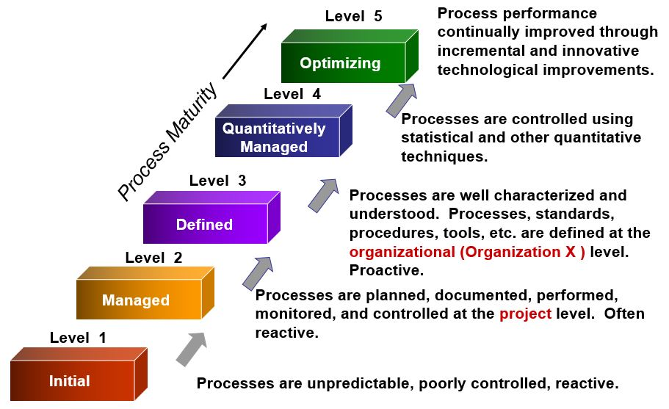
CMMI Maturity Levels

Slide 60
Principal Model Components of CMMI
A set of process areas that are related to software process activities.
A number of goals, which are abstract descriptions of a desirable state that should be attained by an organization.
A set of good practices, which are descriptions of ways of achieving a goal.

Slide 61
Principal Model Components of CMMI
Process Areas:
The CMMI identifies 22 process areas that are relevant to software process capability and
improvement.
These are organized into four groups in the continuous CMMI model.
These groups and related process areas are listed in Figure

Slide 62
Principal Model Components of CMMI- Process Areas

Slide 63
Principal Model Components of CMMI- Process Areas

Slide 64
Principal Model Components of CMMI- Number of Goals
A number of goals, which are abstract descriptions of a desirable state that should be attained by an organization.

